Slide 1
2026 November 03
Can Decision Models
Understand Stance ?
Evaluating Jev Against General Purpose LLMs
Authors: Xing Li, Jinzhong Ning, Yijia Zhang, Liang Yang, Hongfei Lin
Dalian Maritime University
Dalian University of Technology
Presented By :
Hema Meena R

Slide 2
What is Stance Detection ?
Stance detection is the task of identifying a person's position
or opinion toward a particular target.
The paper considers three possible stance labels:
  Favor: The text supports or agrees with the target.
  Against: The text opposes or disagrees with the target.
  Neutral: The text does not clearly support or oppose
the target.
Example:
Target: Online education is beneficial.
      “It provides flexible learning.” → Favor
      “It reduces direct interaction.” → Against
      “Online education is widely used.” → Neutral
FAVOR
Supports or agrees
with the target
AGAINST
Opposes or criticizes
the target
NEUTRAL
No clear position
towards the target

Slide 3
Why is Stance Detection Challenging?
-Identifying a person's stance is not always straightforward.
The meaning of a statement may depend on earlier messages.
Context matters
CONVERSATION
UNDERSTANDING
People may express
agreement or disagreement
without using direct words.
Speaker A :
“Online education
is very useful”
Speaker B :
“I completely
disagrees”
Indirect opinions
A statement may
support one idea
but oppose another.
The speaker and conversation history may be necessary to interpret the actual opinion.
Different targets
The earlier message helps to
interpret the reply
Some text may not clearly express any position.
Ambiguous statements

Slide 4
Research Motivation and Objective
Why did the researchers conduct this study?
  Traditional stance detection approaches often depend on
task-specific labelled datasets.
  General-purpose Large Language Models (LLMs) can also perform stance classification using instructions.
  Stance detection has three predefined output labels:
Favor, Against and Neutral.
  The researchers investigate whether Jev can perform this classification effectively compared with general-purpose LLMs.

Slide 5
Related Work : Stance Detection
1. Target-specific stance detection
  Identifies the relationship between a text and a particular target.
  Example: Understanding whether a text supports or opposes a given topic.
2. Cross-target stance detection
  Transfers knowledge between related targets.
  Reduces the need for labelled data for every target.
3. Zero-shot stance detection
  Identifies stance toward targets that were not seen during training.
  Example: VAST dataset.
4. LLM-based approaches
  Use Large Language Models to identify relationships between text and target.
  Some approaches use LLM-generated knowledge to support stance prediction.

Slide 6
Related Work : Conversational Stance Detection
What is Conversational Stance Detection (CSD)?
Conversational stance detection identifies a speaker's position toward a target by considering the conversation and interactions between speakers.
Important research works:
  SRQ: Studies stance in replies and quoted tweets.
  MT-CSD: Models dependencies across multiple conversation turns.
  GLAN: Combines global and local conversational information.
  ZS-CSD: Introduces a Chinese benchmark for stance detection toward unseen targets.
  SITPCL: Combines speaker interaction with target-aware contrastive learning.

Slide 7









WorkFlow
Jev-Choice Based Decision
Prediction Extraction
Task Instruction
Determine the stance towards the target
FAVOR
INPUT PREPARATION
DATASETS
AGAINST
Extract &
Validate Selected
Label
NEUTRAL
Target
VAST
(Individual text)
Three Choices
Focus Text
FAVOR
AGAINST
Supports or agrees
with the target
Opposes or criticizes
the target
Conversation
History
Evaluation Metrics
ZS-CSD
(Conversational)
NEUTRAL
F1 Score
No clear position
towards the target
Target Type
Accuracy
Metrics
Jev
Select One Option

Slide 8
Datasets , Models and Evalution Metrics
1. Datasets
  VAST: Individual English text – 3,006 test records.
  ZS-CSD: Chinese conversational text – 2,584 test records; focuses on unseen-target stance detection.
2. Models
  Main Model: Jev
  General-Purpose LLMs:
DeepSeek V4.1 Flash, Qwen3.8-Flash, GPT-5.6, Claude Sonnet 5.
  Fine-Tuned Reference Models: Qwen2.5-3B (LoRA), Qwen2.5-7B (LoRA).
3. Evaluation Metrics
  Accuracy: Measures the overall percentage of correct predictions.
  Macro-F1 Score: Measures performance across Favor, Against, and Neutral classes.
  Token Usage: Measures the number of tokens consumed.
  API Cost: Measures the cost of processing the dataset.

Slide 9


Different Stages
1
2
32
TASK DEFINITION
STRUCTURED INPUT CONSTRUCTION
JEV CHOICE BASED DECISION
FAVOR
AGAINST
Identify the stance of the focus text towards a given target.
NEUTRAL
  Prepare the input using:
      Target
      Focus text
      Conversation history
      Target type
  Preserve the original language and conversation order.
  Provide the task instruction and three stance options to Jev.
  Jev selects exactly one option based on the given criteria:
      Favor – Support or approval
      Against – Opposition or criticism
      Neutral – No clear stance
FAVOR
AGAINST
NEUTRAL
4
PREDICTION EXTRACTION
  Extract the selected option from Jev's response.
  Validate the selected label.
  Use it as the final stance prediction.

Slide 10
Complete Example : Input To Prediction
  Target
Online education is better than classroom education
  Conversation History
Predicted
Speaker A : “Online education gives students more flexibility.”
AGAINST
AGAINST
  Focus Text
Speaker B : “I completely disagree. Studemts learn better through direct classroom interaction.”

Slide 11
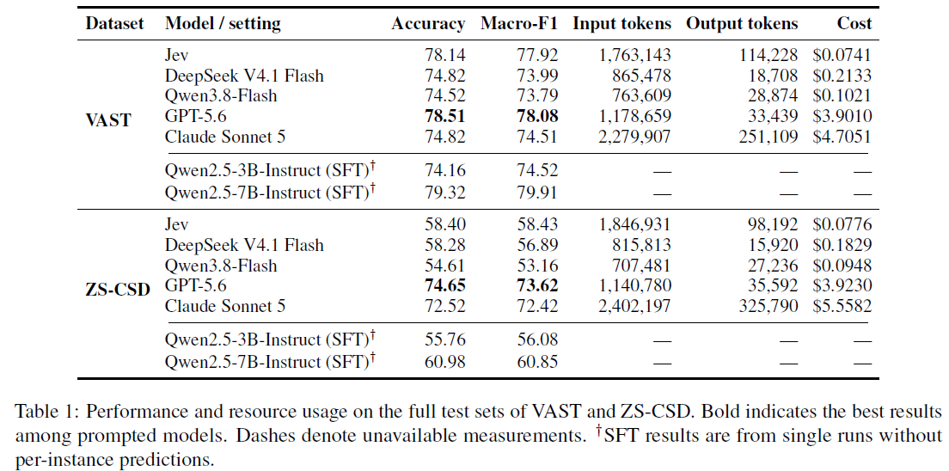
Results

Slide 12
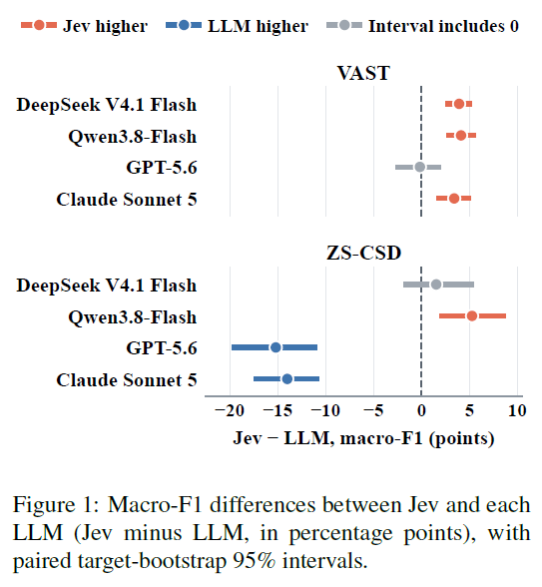
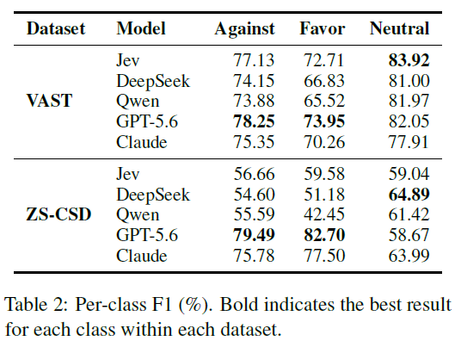
Results

Slide 13
2026 November 03
Thank you
The End

